Slide 1
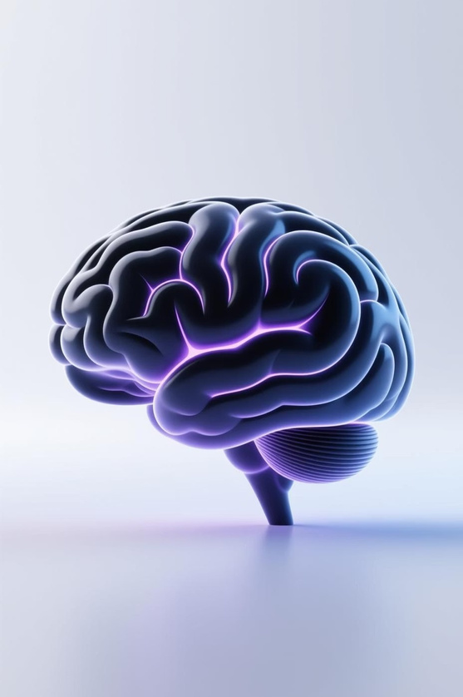
MindMate AI í
Your Gentle Mental Health Companion
RAHULKHATICO-FOUNDER&CEO

Slide 2

Mental Health Support is Hard to Access
Manyindividuals navigate dailystruggleswith stress, anxiety, and
overwhelming emotions. The need for immediate,empathetic support is more critical than ever, yet it often remains outof reach for those who need it most.
Current systems struggle to provide timely and personalized care,
leaving many feeling isolated and unsupported in their mental
wellness journey.

Slide 3
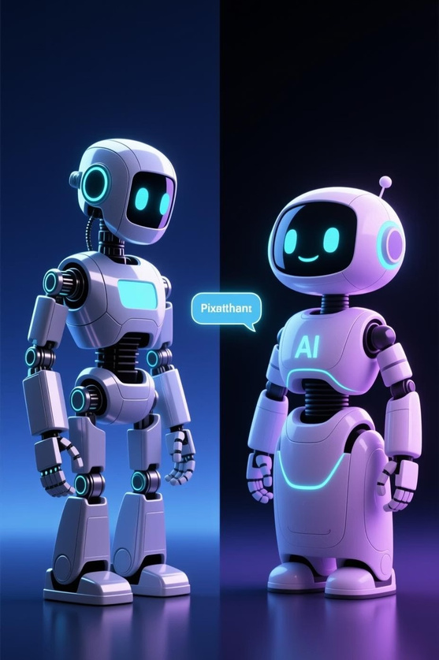


People Want a Friend, Not Just a Bot
Generic Chatbots
Most existing chatbots offer standard,rule-based responses thatoften
lack thenuancedunderstandingrequired for sensitivemental health conversations. Theycan feel impersonal and fail to address the user's true emotional state.
MindMate AI
MindMateAI is designed with advanced emotional awareness, allowing it
tounderstand and respond with genuine empathy. This makes interactions feel more human, fostering a sense of connection and trust.

Slide 4
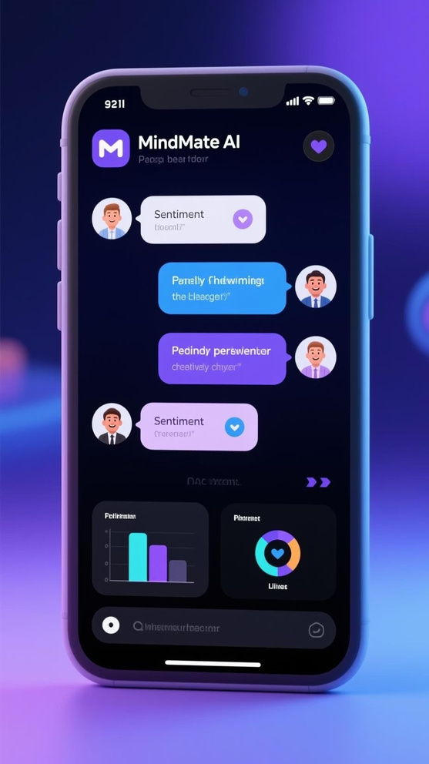
MindMate AI: Gentle, Responsive, Emotionally Aware
MindMate AI stands out by combining cutting-edge technology with a human-
centric approach to mental wellness support.
LLM-Powered Chat
Real-time Sentiment Detection
Utilizing advanced Large
Language Models (OpenAI or local
options) for intelligent and
context-aware conversations.
Incorporates DistilBERT for
precise emotional analysis,
ensuring responses are always
appropriate and supportive.
Clean, Responsive UI
Built with React + Vite for a seamless, intuitive user experience across all
devices.

Slide 5


in Action: How It WorksTechnology
MindMateAIleveragesapowerful,integratedpipelinetodeliverimmediateandempathetic support.
UserInputs Text
Users share their thoughts and feelings through the intuitive chat interface.
Sentiment ModelAnalyzes Emotions
Our DistilBERT model processes the input, identifying the underlying emotional tone.
LLMGeneratesEmpathetic Response
The Large Language Model crafts a supportive and understanding reply, tailored to the user's emotional state.
FrontendDisplaysResultin Real-Time
The user receives immediate, gentle guidance and validation.

Slide 6
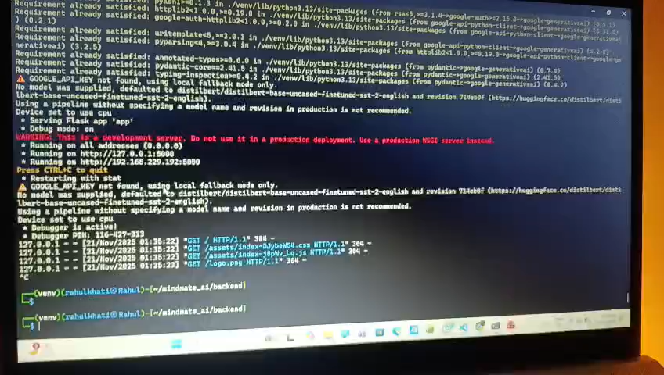

Slide 7
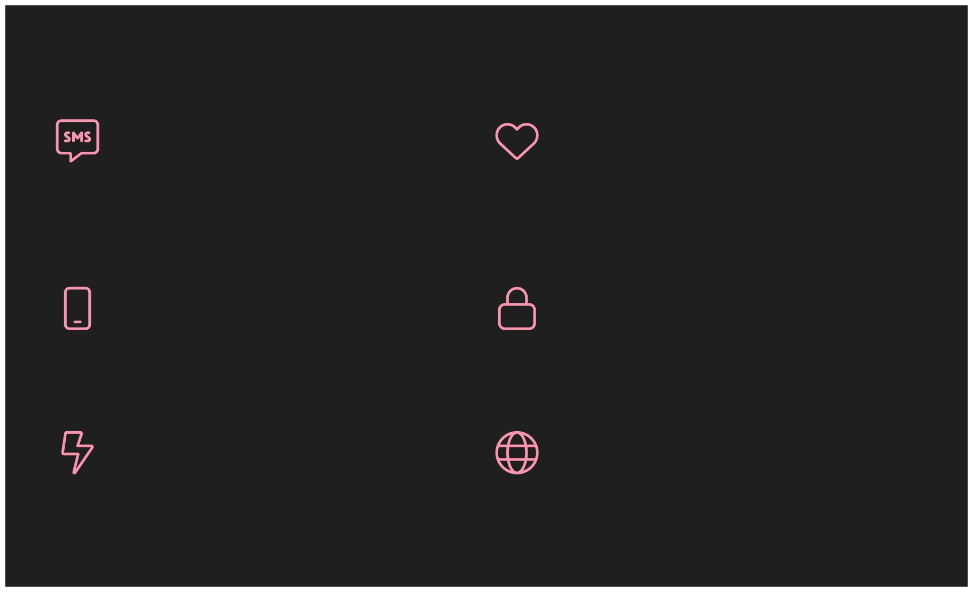
Key Features That Make a Difference
Intelligent AI Chat
Accurate Emotion Detection
PoweredbyOpenAIor adaptable to local LLMs for flexible, smart conversations.
Real-timesentimentanalysisensures genuinely empathetic
interactions.
Seamless Responsive UI
Secure Backend
Beautifullydesignedforaconsistent experience on any device.
ProtectedbyAPIkeys, ensuring data privacy and robust security.
Fast & Lightweight
Deployment Ready
Optimizedforquickresponses and efficient resource usage.
Builtforeasyandscalable deployment across various platforms.

Slide 8
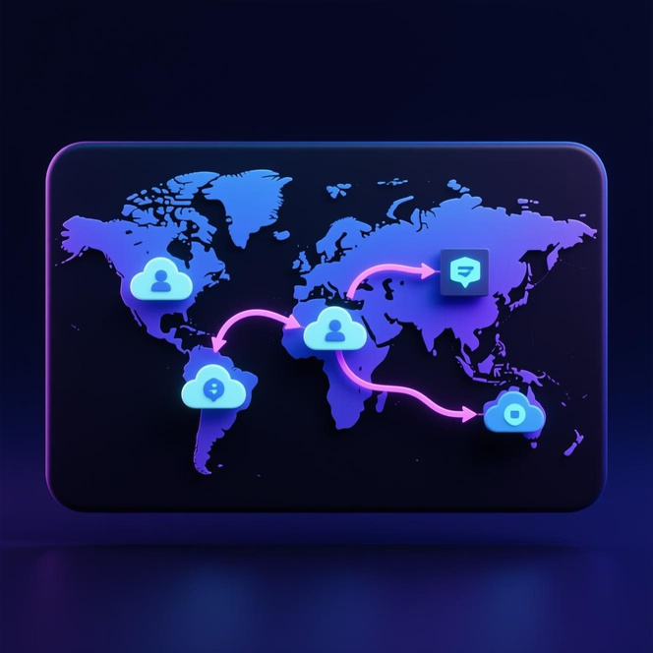
Deployment & Accessibility: Ready to Go Anywhere
MindMate AI is engineered for robust performance and wide accessibility, ensuring it can reach users wherever they are.
Backend Hosting Options
Production-Ready & Secure
Render: Managed cloud platform for easy deployment and scaling.
Railway: Developer-friendly infrastructure for rapid iteration.
VPS (Virtual Private Server): Complete control for custom environments.
The entire application is configured with ENV variables to protect sensitive information, making it suitable for production environments right out of the box. Our architecture prioritizes security and scalability.
Frontend Hosting Options
Vercel: Fast, reliable hosting for modern web applications. Netlify: All-in-one platform for continuous deployment.

Slide 9
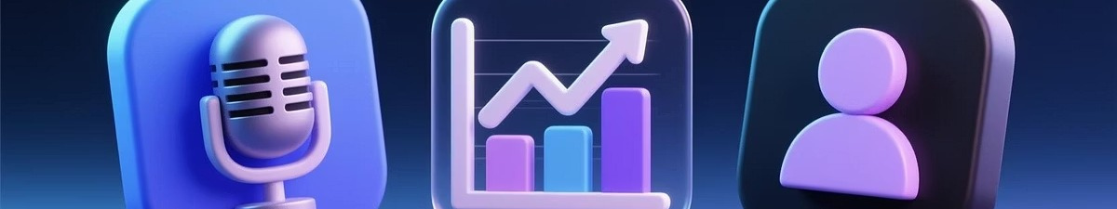
What9s Next: Enhancing the MindMate AI Experience
We are continuously innovating to bring even more powerful and intuitive features to MindMate AI.
Voice Interaction
Emotion Charts
Personalized Wellness Recommendations
Allow users to speak their thoughts,
making interactions more natural and
accessible.
Visualize emotional patterns over time,
offering insights into personal wellness
journeys.
Provide tailored suggestions for self- care and mental health resources.

Slide 10
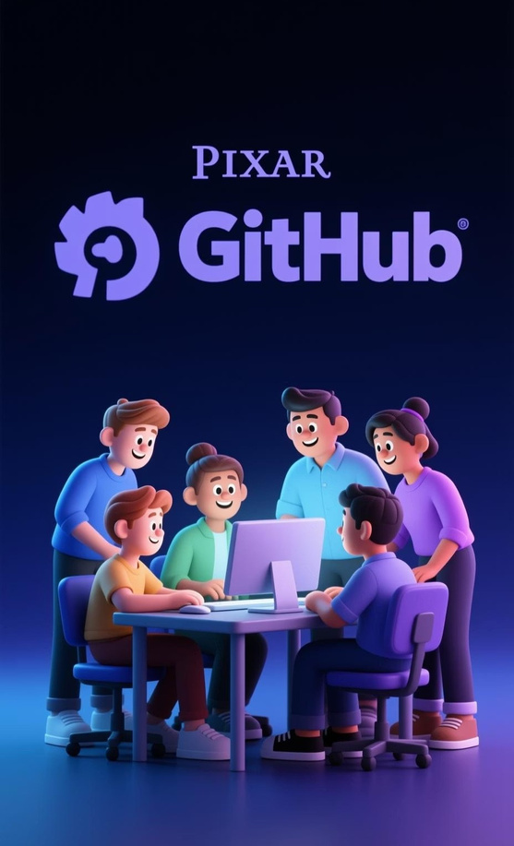


Join Our Mission: Contribute to MindMate AI
MindMateAIisanopen-sourceprojectdrivenbycommunitycontributions. We
believe thatbyworkingtogether,wecanmakeagreaterimpactonmental health accessibility.
Pull Requests Welcome
Whether it's bug fixes, new features, or code improvements, your
contributions are invaluable.
Open Issues for New Features
Have an idea for enhancing MindMate AI? Create an issue to discuss and
collaborate on new features.

Slide 11
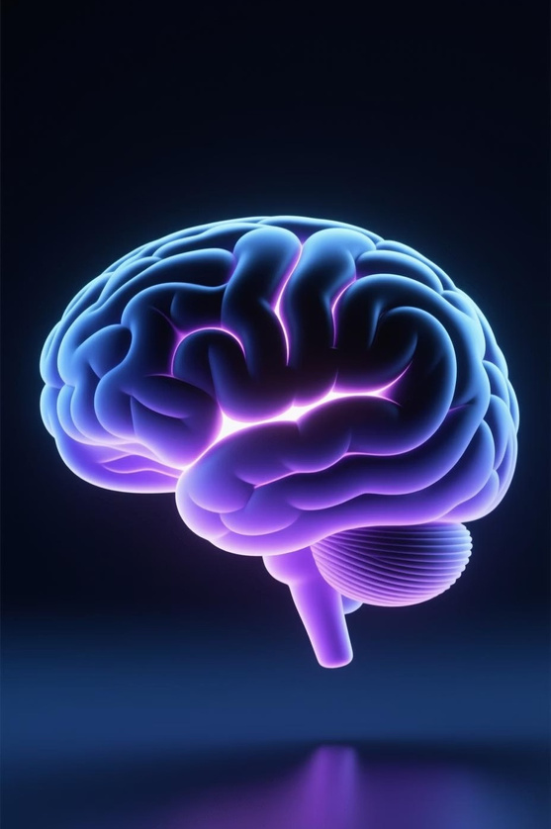
Thank You!
Let9smakementalhealth support accessible to everyone

